Slide 1
Voice Classification using deep learning
Pranav Sankhe Sujit Singh Varun Shijo

Slide 2
Quad Chart Pranav Sankhe, Sujit Singh, Varun Shijo
Title: Voice Classification using Deep Learning Lecture Topics: Chapter 6: Deep Feedforward Nets Chapter 9: Convolutional Neural Networks Chapter 10: Recurrent Neural Networks Task Title: Comparison of accuracy of classification of sounds in the Urban Sound dataset using MLP, RNN and CNN. | Task description: To classify voice by converting them to spectrograms and using the time series representation as input for three deep neural networks architectures, namely: Multilayer Perceptron, Convolutional Neural Networks and Recurrent Neural Networks. Dataset Description: This dataset contains 8732 labeled sound excerpts (<=4s) of urban sounds from 10 classes: air_conditioner, car_horn, children_playing, dog_bark, drilling, enginge_idling, gun_shot, jackhammer, siren, and street_music.
Models: Multilayer Perceptron, Convolutional Neural Networks, and Recurrent Neural Networks. Optimizer: Gradient Descent, Adam Cost: Negative LogLikelihood, CrossEntropy Parameters: Stride length 2 for conv2d [1, 2, 2, 1] where corresponding dimensions are [batch, height, width, channels] Image type: MFCC Spectrogram of input audio Dimensions of image will depend on sampling rate and frequency range of audio (16kHz to 96kHz, 50Hz-18kHz to 20Hz - 22kHz) | Expected Results: The paper covering the dataset documents an accuracy of ~70% (SVM and Random Forest) We aim to find the accuracy by implementation for CNN, RNN and MLP. We also aim to study the resultant confusion matrix to determine confidence of prediction for similar classes where models usually exhibit lower confidence. Foreground and background features vary in their manifestation and the ability to classify them differs. We also aim to study the difference in accuracy of prediction for these two cases.
Notes:
Mel Frequency Cepstral Coefficient

Slide 3
Dataset
UrbanSounds 8K
8732 labeled sound excerpts
4 seconds in length
WAV files (lossless)
10 classes: air_conditioner, car_horn, children_playing, dog_bark, drilling, enginge_idling, gun_shot, jackhammer, siren, and street_music

Slide 4
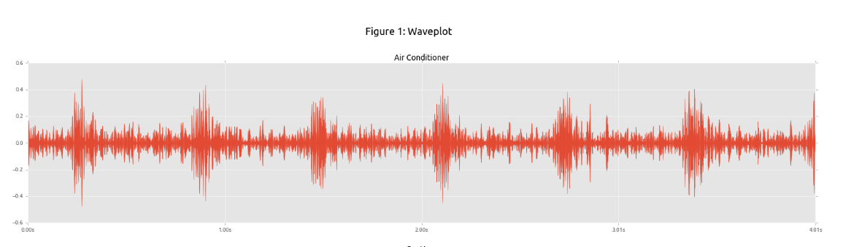
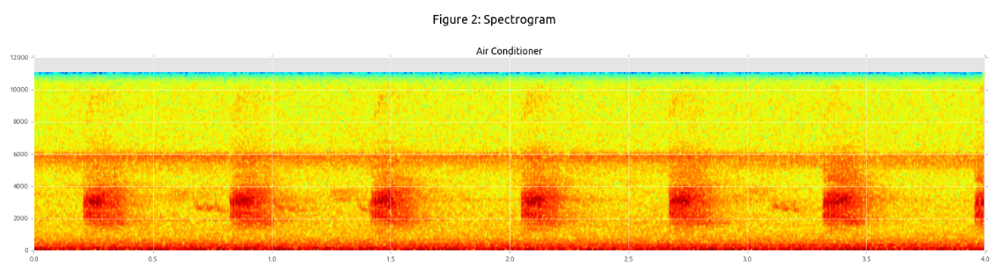
Preprocessing
Librosa – Audio processing library for python
Loading wav files: returns sampling rate and time series
Power spectrogram and wavefrom as arraylike objects
Matplotlib – graphing library for python
Specgram method plots spectrograms

Slide 5
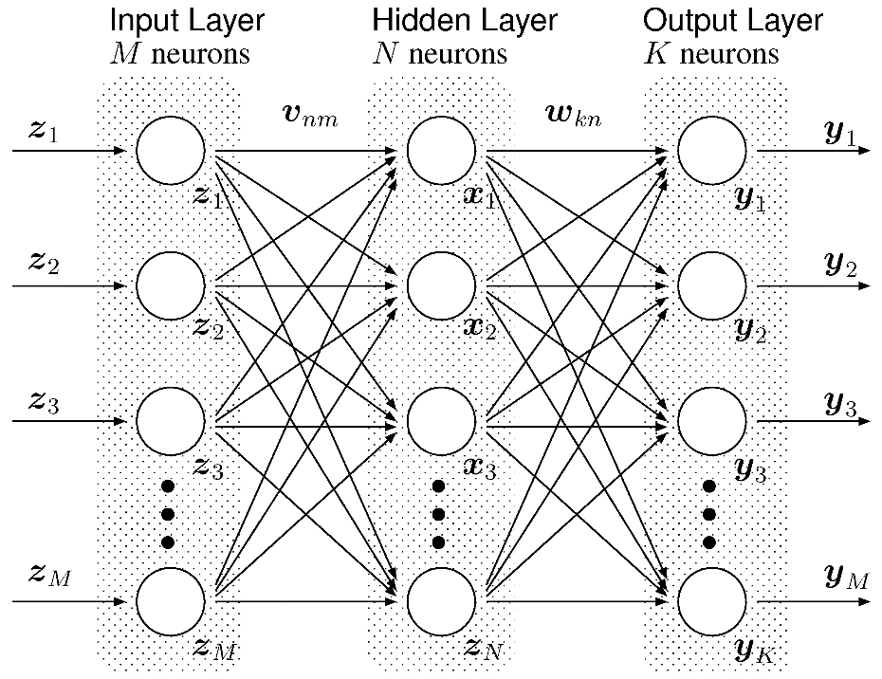
Architecture
Multilayer Perceptron
Parameters:
Number of epochs
Learning rate
Activation function
Loss function
Number of hidden layers

Slide 6
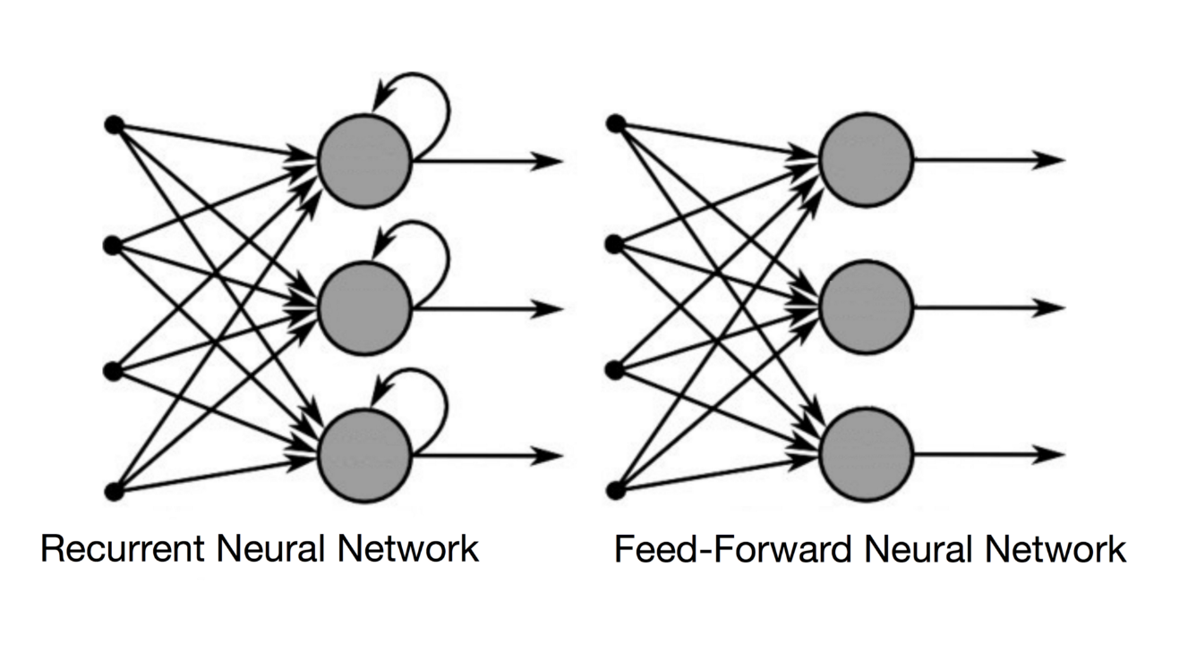
Architecture (contd.)
Recurrent Neural Network
Parameters (Similar to MLP)
Output from nodes are fed back to same node as input to account for previously learnt information.
Thus useful while dealing with applications that benefit from temporal dependence.

Slide 7
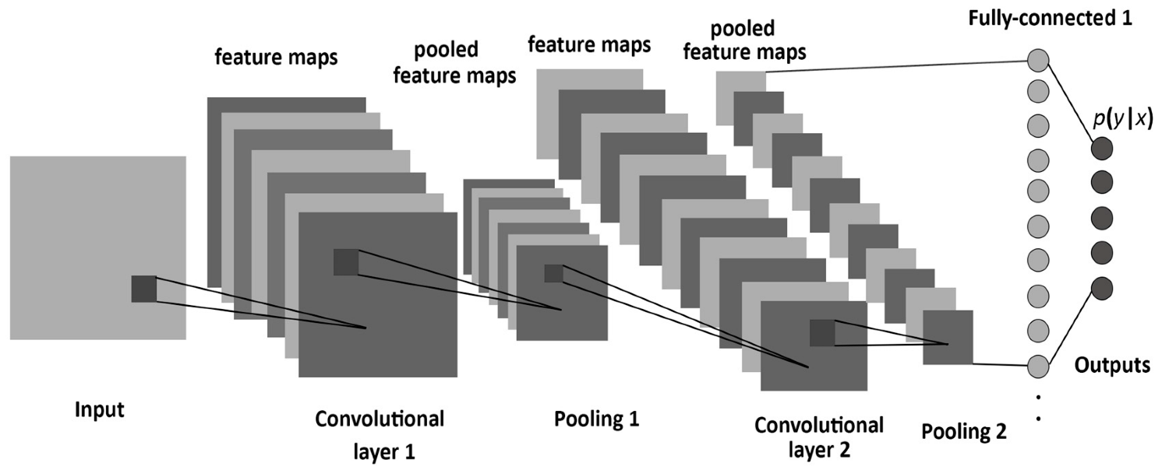
Architecture (contd.)
Convolutional Neural Network
Convolutional window that convolves over the image to generate an output that ultimately results in feature extraction.
Parameters:
Stride, Window size, Padding
Learning Rate
Epochs
Optimizer
Number of layers
Activation function
Pooling layers

Slide 8
Inference
Attempting to compare the results across various learning techniques
We expect to achieve maximum accuracy using CNNs given the fact that input is in the form of an image that is best dealt with using CNNs.
We aim to develop a robust system using deep learning techniques and learn to tune the parameters and the architecture itself.
We also aim to study the confusion matrix to observe which classes are frequently misclassified and try to reason it.

